Slide 1

ME 200 Thermodynamics
Lecture 07 – Tables

Slide 2
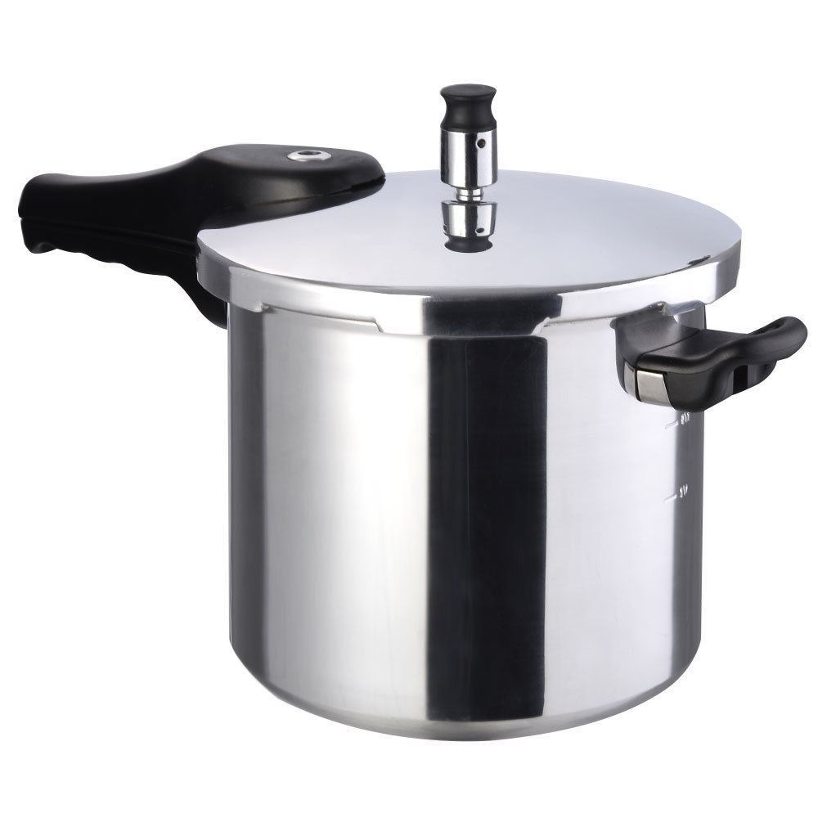
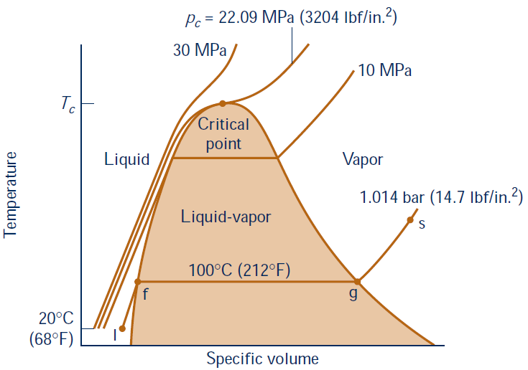
Pressure Cooker
What controls the cooking pressure?
Notes:
When was the pressure cooker invented? It was invented in the 1600s by a Frenchman by Denis Papin, who wanted to translate new discoveries in physics about pressure and steam into cooking. He called his pot the “Digester” but it took quite a while before better manufacturing standards and technology could make these high pressure pots safe.
A short video intended to show kids how pressure cooking works.
How does a pressure cooker work? A pressure cooker is a sealed pot with a valve that controls the steam pressure inside. As the pot heats up, the liquid inside forms steam, which raises the pressure in the pot. This high pressure steam has two major effects:
Raises the boiling point of the water in the pot. When cooking something wet, like a stew or steamed vegetables, the heat of your cooking is limited to the boiling point of water (212°F). But with the steam’s pressure now the boiling point can get as high as 250°F. This higher heat helps the food to cook faster.
Raises the pressure, forcing liquid into the food. The high pressure also helps force liquid and moisture into the food quickly, which helps it cook faster and also helps certain foods, like tough meat, get very tender very quickly.
The extra-high heat of the pressure cooker also promotes caramelization and browning in a surprising way — we’re not used to food caramelizing when it is cooking in liquid. But the flavors created in a pressure cooker can be really deep and complex — unlike regular steamed foods.

Slide 3
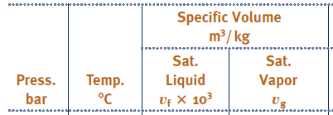
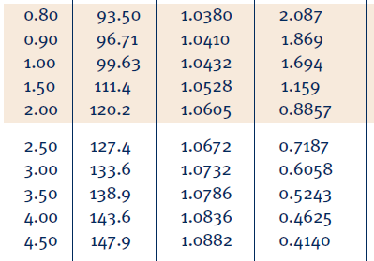
Example
A pressure cooker has a weight that is 0.5 kg that rests on a 5 mm diameter hole. What is the cooking temperature and pressure for the cooker?
99.6 ºC
111.4 ºC
127.4 ºC
138.9 ºC
147.9 ºC

Slide 4
Example
Water is at 100 ºC and v = 0.1 m³/kg. Examine the state.
Notes:
Start with temperature table, smaller than saturated vapor and gas

Slide 5
Example
Water is at 80 ºC and 35 bars.
What phase of matter is the water?
What is u (kJ/kg)?
332.19
333.72
333.98
334.06
334.29
Liquid
L+V
vapor

Slide 6
Example
Water is at 80 ºC and 35 bars.
What phase of matter is the water?
What is u (kJ/kg)?
332.19
333.72
333.98
334.06
334.29
Liquid
L+V
vapor
Notes:
1.5 minutes
D and C are quite close… LOOK at TABLE

Slide 7
Example
What is the saturation temperature for water with
v = 0.2 m³/kg & u = 1600 kJ/kg??
110 C
130 C
150 C
170 C
180 C
Notes:
3 minutes…Note Table A-2

Slide 8
Example
R22 with v = 0.0065 m³/kg and u = 162 kJ/kg. Find T, p, x.
Need trial and error to find the properties.
Guess T …
Because the tables are tabulated using T or P as the main parameters, not v or u
Notes:
Table A-7

Slide 9
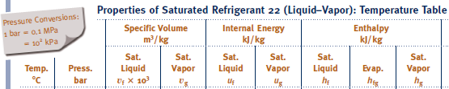
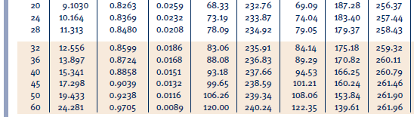
Example
R22 with v = 0.0065 m³/kg and u = 162 kJ/kg. Find T, p, x.
Notes:
Table A-7

Slide 10


Example
R22 with v = 0.0065 m³/kg and u = 162 kJ/kg. Find T, p, x.
$$find x$$
$$@45℃ v get x=0.455; u get x=0.449 →close enough$$
$$P=17.298 bar; x=0.45$$
Notes:
Table A-7

Slide 11
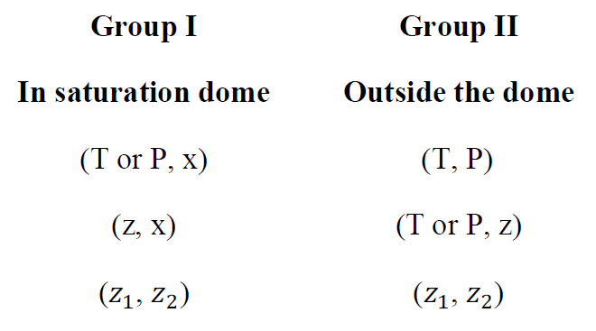
To Find Properties
Notes:
Outside of saturated dome, x means NOTHING

Slide 12
To Find Properties
direct
direct
trial & error
direct
trial & error
direct, but usually needs double interpolation
(T or P, z) direct
Notes:
Outside of saturated dome, x means NOTHING

Slide 13
Example – Cans
There are 2 aluminum cans: CAN A contains air, and CAN B has 10% water. They were open to atmosphere and heated up from room temperature to 100 C then sealed. After they are securely sealed, both cans were placed into a room temperature water bath (20 C) to cool them down quickly. What would happen?
CAN A will explode
CAN A will collapse
CAN B will explode
CAN B will collapse
Nothing happen
Notes:
1 minute to THONK

Slide 14




Example – Cans
There are 2 aluminum cans: CAN A contains air, and CAN B has 10% water. They were open to atmosphere and heated up from room temperature to 100 C then sealed. After they are securely sealed, both cans were placed into a room temperature water bath (20 C) to cool them down quickly. What would happen?
$$Air:R=\frac{Pv}{T} v_{1}=v_{2}$$
$$Water:P_{1}=101 [kPa]$$
$$P_{2}=\frac{T_{2}}{T_{1}}P_{1}=\frac{293}{373}101\left[kPa\right]=79 [kPa]$$
$$20℃, P_{2}=2.3 [kPa]$$
Notes:
1 minute to THONK

